Slide 1

Arduino Crash Course Workshop
EGR 121

Slide 2
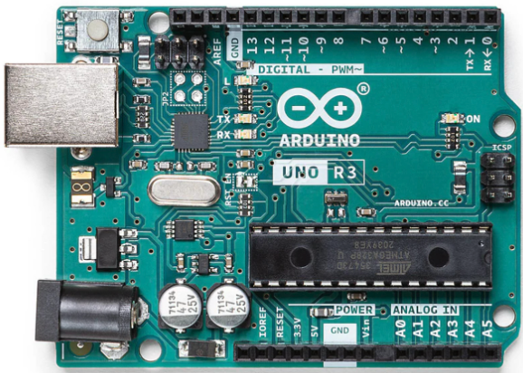
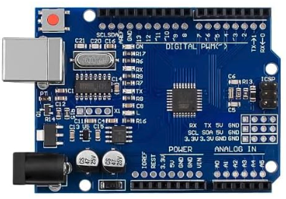
Arduino?
A family of embedded hardware modules made for prototyping an education. Allows for custom software and hardware design projects. Language support and capabilities vary by model.
Original
Clone

Slide 3
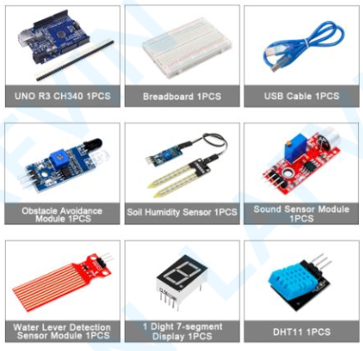
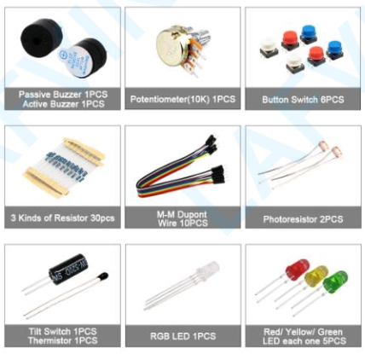
Parts

Slide 4
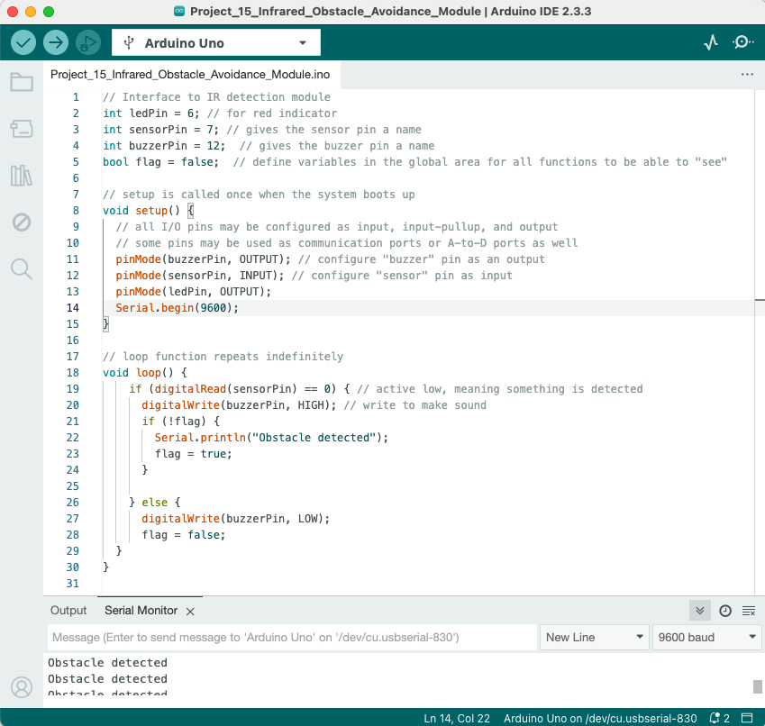
IDE
Connected Hardware
Compile
Upload
Coding Area
Serial Debug

Slide 5
Key Points
Open-Source Hardware and Software (many clones available)
Broad ecosystem for add-on hardware (shields) and a wealth of training and tutorials freely available.
Not a toy. Arduinos often serve as a prototype for a commercial product or application.
An excellent vehicle to learned embedded programming, electronics, digital controls, robotics, IoT applications, etc.,

Slide 6
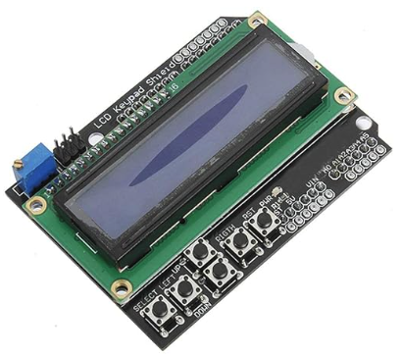
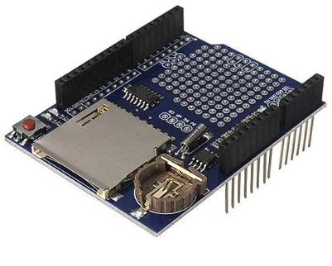
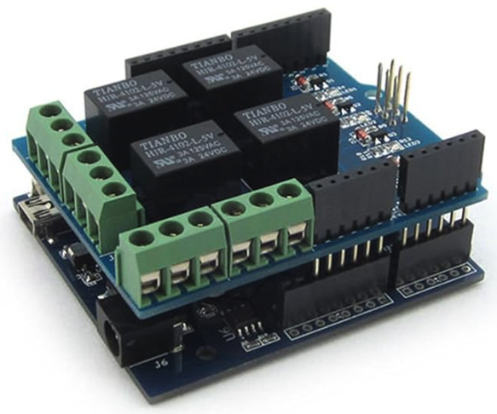
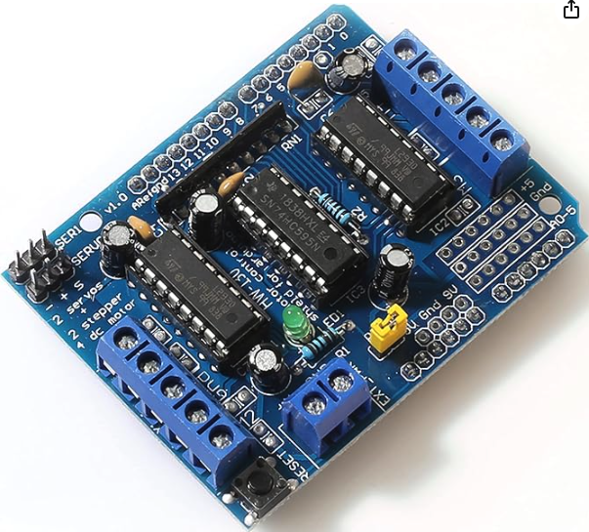
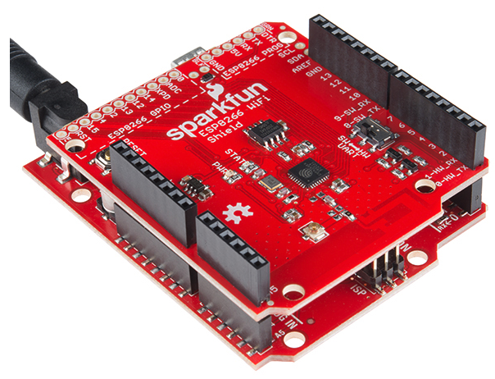
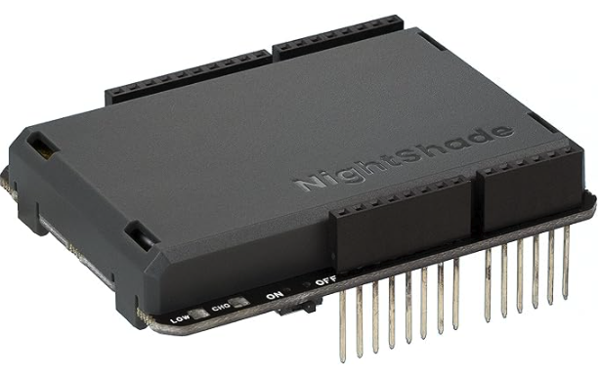
Expansion Shields

Slide 7
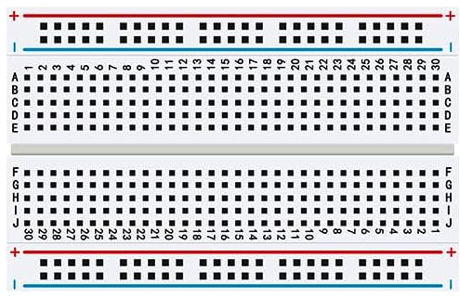
Breadboard Basics
Beware: breadboards are great for experimenting and prototype but not reliable in applications.
Used for power bus, as pins are connected together.
Verticals are connected together but not across divide.

Slide 8
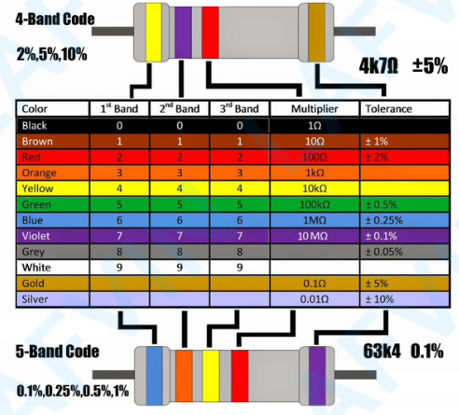
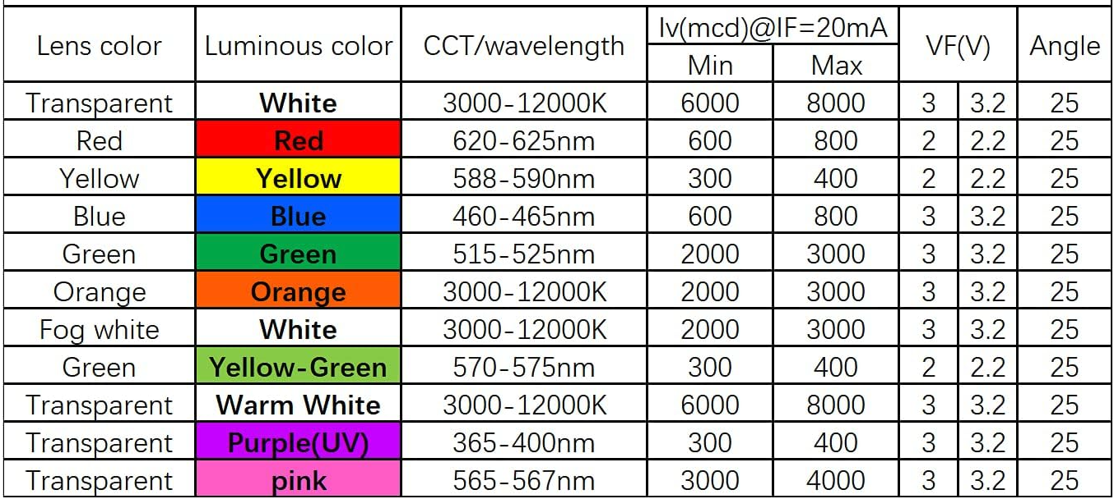
Extra Info

Slide 9
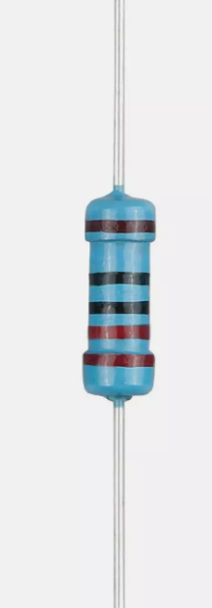
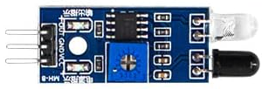
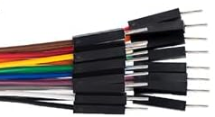
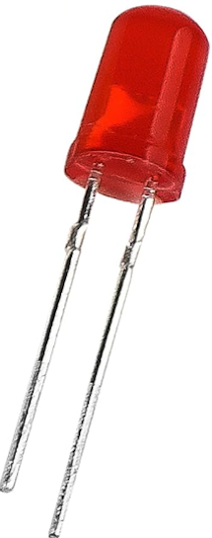
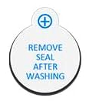
Other Parts in Workshop
Color bands indicate value (see card in kit)
Easily peeled apart
Long lead is Anode
Note Polarity
Note pinout
IR Detection Module
Active Buzzer
Jumper Wires for Breadboard Wiring
220 ohm resistor
Red LED

Slide 10
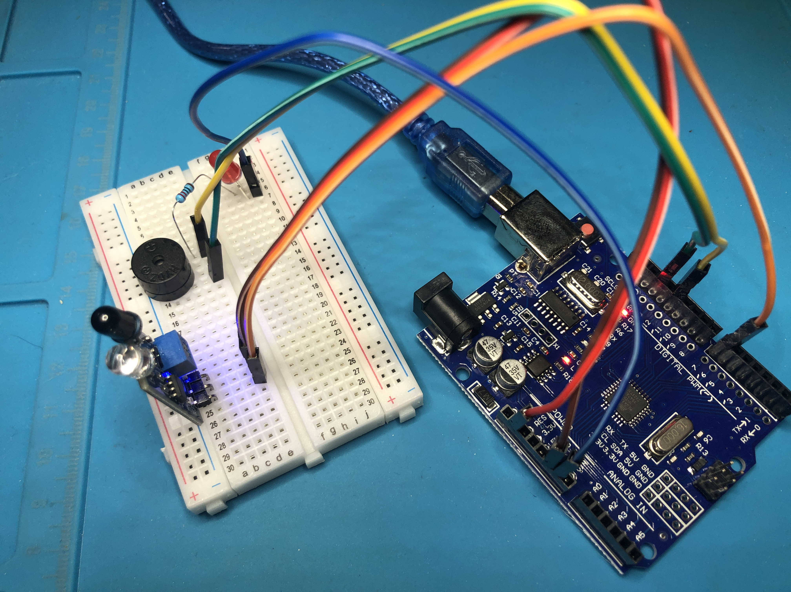
How to Wire

Slide 11
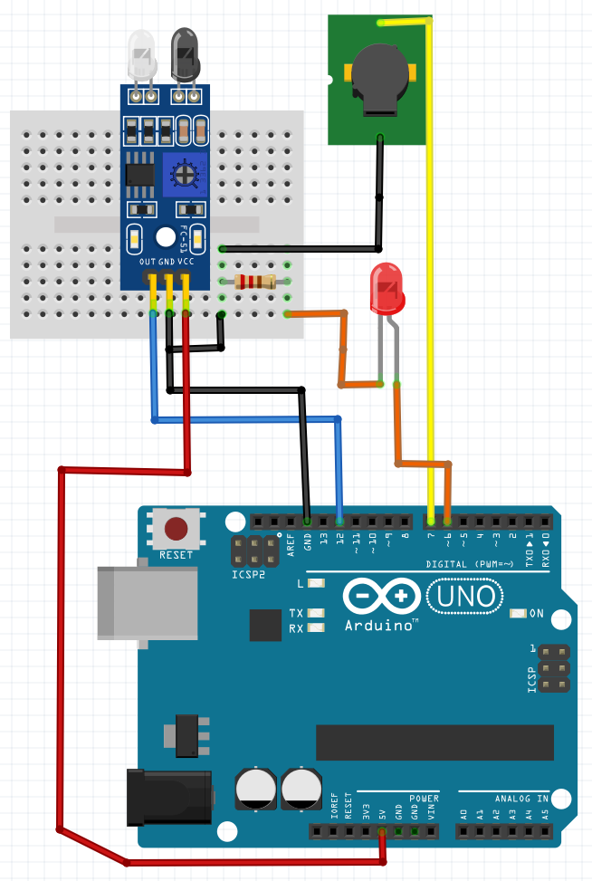
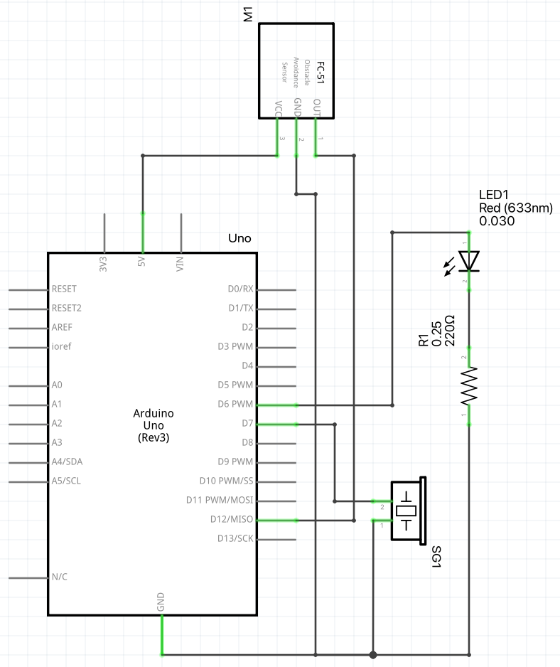
Schematic

Slide 12
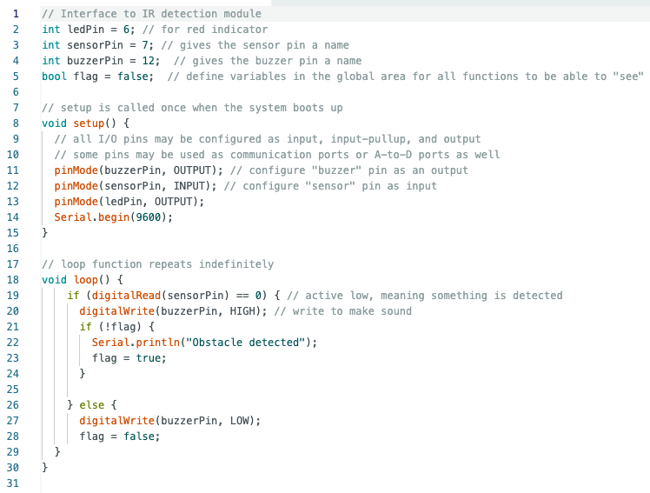
Code

